Slide 1


Jack Vance
7/22/2022

Slide 2

Outline
Executive Summary
Introduction
Methodology
Results
Conclusion
Appendix

Slide 3
Executive Summary
Summary of methodologies
Data was thoroughly explored to understand variable relationships and process timeline (how outcomes and relationships have shifted over time).
Logistic Regression, Support Vector Machine Decision Tree, K-Nearest Neighbors models were evaluated with algorithmic parameter optimization using a grid search method.
Summary of all results
Predictive models were build which produced somewhat reliable predictions on test data.
A larger quantity of data would assist in refining models.
There are likely additional parameters that would be more relevant to predictive algorithms, and have been captured, but are withheld for proprietary concerns. Access to this data could substantially improve model reliability.

Slide 4
Introduction
Project background and context
Sometimes rockets blow up! That’s no good.
Problems you want to find answers
We want to be able to predict with confidence when rockets will blow up. Unfortunately, we don’t have access to a whole lot of relevant data. Luckily, we do have Wikipedia (and a very superficial API from SpaceX themselves).

Slide 5

Section 1

Slide 6
Methodology
Executive Summary
Data collection methodology:
Data was collected from the SpaceX API and a launch list table from Wikipedia.
Perform data wrangling
Landing outcomes replaced with “Class” property, where 1=successful and 0=failure
Perform exploratory data analysis (EDA) using visualization and SQL
Perform interactive visual analytics using Folium and Plotly Dash
Perform predictive analysis using classification models
Classification models were tuned with grid search, and testing with a classic train/test split methodology

Slide 7
Data Collection
Describe how data sets were collected.
You need to present your data collection process use key phrases and flowcharts
Data was collected from interface with the SpaceX API and from webscraping of a Wikipedia page titled “List of Falcon 9 and Falcon Heavy launches”
API: https://api.spacexdata.com/v4/launches/past
Wiki: https://en.wikipedia.org/wiki/List_of_Falcon_9_and_Falcon_Heavy_launches
Data Collection
SpaceX API Responses
Data Processing (“Wrangling”)
Wiki Webscraping Results

Slide 8
Data Collection – SpaceX API
Present your data collection with SpaceX REST calls using key phrases and flowcharts
Add the GitHub URL of the completed SpaceX API calls notebook (must include completed code cell and outcome cell), as an external reference and peer-review purpose
https://github.com/JackVance/coursera-ML-capstone/blob/main/jupyter-labs-spacex-data-collection-api.ipynb
Use request.get(…).json() to obtain json responses from API
Parse json responses for relevant data, through dictionary and then to panadas dataframe
Filter dataframe to include only Falcon 9 launches
Remove null/NaN/None values (except for landing pad, which has a valid ‘None’ case)
Save final dataframe to .csv
(“dataset_part_1.csv”)

Slide 9
Data Collection - Scraping
Present your web scraping process using key phrases and flowcharts
Add the GitHub URL of the completed web scraping notebook, as an external reference and peer-review purpose
https://github.com/JackVance/coursera-ML-capstone/blob/main/jupyter-labs-webscraping.ipynb
Import data from .csv file (obtained from SpaceX API) to pandas dataframe
Parse launch tables from BeautifulSoup object to dictionary object (“launch_dict”)
Convert launch_dict to pandas dataframe object
Save pandas dataframe object to .csv
(“spacex_web_scraped.csv”)
9

Slide 10
Data Wrangling
Describe how data were processed
Only change at this stage is addition of a column to represent good/bad landing outcomes. 0=bad, 1=good.
You need to present your data wrangling process using key phrases and flowcharts
Add the GitHub URL of your completed data wrangling related notebooks, as an external reference and peer-review purpose
https://github.com/JackVance/coursera-ML-capstone/blob/main/labs-jupyter-spacex-Data%20wrangling.ipynb
Use BeautifulSoup to get parsing of html from Wikipedia page
Exploratory Data Analysis was performed to investigate data:
-# of Launches by Launch Site
-# and % of Orbit types
-# and % of Mission Outcome by Orbit type
Add binary/boolean label (0/1) to represent bad/good (respectively) landing outcomes, to new “Class” column.
10
10
Save new pandas dataframe object to .csv
(“dataset_part_2.csv”)

Slide 11
EDA with Data Visualization
Summarize what charts were plotted and why you used those charts
Payload Mass vs Flight Number vs Class/Landing Outcome (color-coded)
Illustrates how Payload Mass changes with Flight number, and how both affect Landing Outcome
Launch Site vs Flight Number vs Landing Outcome (color-coded)
Illustrates how Launch Sites varied with Flight Number, and how they relate to Landing Outcome
Launch Site vs Payload Mass vs Landing Outcome (color-coded)
Illustrates how different Launch Sites tend to see different payload masses and/or limits, and related mission outcomes
Landing Outcome vs Orbit type
Illustrates how Landing Outcomes correlate with Orbit types
Orbit type vs Flight Number vs Landing Outcome (color-coded)
Illustrates how Orbit types vary with flight number, and how both relate to Landing Outcome
Orbit type vs Payload Mass vs Landing Outcome (color-coded)
Illustrates how Orbit types relate to payload mass and correlate with landing outcome
Landing Outcome vs Year
Illustrates how landing outcome success rate improves over time
Add the GitHub URL
https://github.com/JackVance/coursera-ML-capstone/blob/main/jupyter-labs-eda-dataviz.ipynb

Slide 12
EDA with SQL
Using bullet point format, summarize the SQL queries you performed
Display the names of the unique launch sites in the space mission:
SELECT DISTINCT "Launch_Site" FROM SPACEXDATASET
Display 5 records where launch sites begin with the string 'CCA’:
SELECT * from SPACEXDATASET where "Launch_Site" like 'CCA%' limit 5
Display the total payload mass carried by boosters launched by NASA (CRS):
SELECT(sum("PAYLOAD_MASS__KG_")) as "NASA_CRS_net" from SPACEXDATASET where "Customer"='NASA (CRS)’
Display average payload mass carried by booster version F9 v1.1:
select(avg("PAYLOAD_MASS__KG_")) as AVG_F9_Payload from SPACEXDATASET where "Booster_Version" LIKE 'F9 v1.1%’
List the date when the first succesful landing outcome in ground pad was achieved:
select min(Date) from SPACEXDATASET where Landing_Outcome = 'Success (ground pad)’
List the names of the boosters which have success in drone ship and have payload mass greater than 4000 but less than 6000:
select Booster_Version, PAYLOAD_MASS__KG_ from SPACEXDATASET where Landing_Outcome = 'Success (drone ship)' and PAYLOAD_MASS__KG_ between 4000 and 6000
List the total number of successful and failure mission outcomes:
select Mission_Outcome, count(*) from SPACEXDATASET group by Mission_Outcome
List the names of the booster_versions which have carried the maximum payload mass. Use a subquery:
select Booster_Version, PAYLOAD_MASS__KG_ from SPACEXDATASET where PAYLOAD_MASS__KG_ = (select max(PAYLOAD_MASS__KG_) from SPACEXDATASET)
List the records which will display the month names, failure landing_outcomes in drone ship ,booster versions, launch_site for the months in year 2015:
select Booster_Version, Launch_Site, Landing_Outcome, monthname(Date) as Month, year(Date) as Year from SPACEXDATASET where Landing_Outcome = 'Failure (drone ship)’ and year(Date) = 2015
Rank the count of successful landing_outcomes between the date 04-06-2010 and 20-03-2017 in descending order:
select count(*) as Count, Landing_Outcome from SPACEXDATASET where Landing_Outcome like '%Success%’ and Date > '2010-06-04’ and Date < '2017-03-20’ group by Landing_Outcome
Add the GitHub URL:
https://github.com/JackVance/coursera-ML-capstone/blob/main/jupyter-labs-eda-sql.ipynb

Slide 13
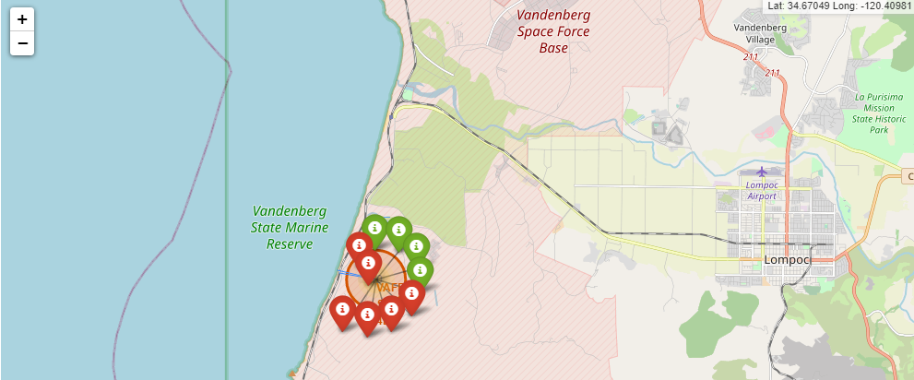
Build an Interactive Map with Folium
Summarize what map objects such as markers, circles, lines, etc. you created and added to a folium map
Explain why you added those objects
Marked all launch sites, with markers and labels
To identify where each launch site is located
Labeled total launch counts and identified successful/failed launches
To visualize how launch sites compare to launch success rate
Measured distances between VAFB and proximal landmarks (coast, railway)
To understand how launch sites are positioned relative to infrastructure
Add the GitHub URL of your completed interactive map with Folium map, as an external reference and peer-review purpose
https://github.com/JackVance/coursera-ML-capstone/blob/main/lab_jupyter_launch_site_location.ipynb

Slide 14
Build a Dashboard with Plotly Dash
Summarize what plots/graphs and interactions you have added to a dashboard
Explain why you added those plots and interactions
Mission successes by launch site and payload range, as a pie chart
To illustrate launch site distribution, or success rate for individual launch sites
Payload Mass vs class (success/failure) and booster version category
To illustrate how payload mass correlates with class and booster version category for the selected launch site(s) and payload range
Add the GitHub URL of your completed Plotly Dash lab, as an external reference and peer-review purpose
https://github.com/JackVance/coursera-ML-capstone/blob/main/spacex_dash.py

Slide 15
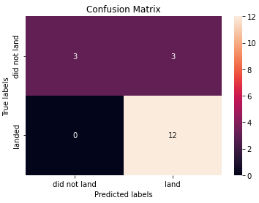
Predictive Analysis (Classification)
Summarize how you built, evaluated, improved, and found the best performing classification model
Data was “standardized” (processed into std dev from mean)
Split into test and train data
Train data used to create and optimize various model types
Performance evaluated using test data and confusion matrices (all models performed equally well.)
Add the GitHub URL of your completed predictive analysis lab, as an external reference and peer-review purpose
https://github.com/JackVance/coursera-ML-capstone/blob/main/SpaceX_Machine%20Learning%20Prediction_Part_5.ipynb
Transform input data into standard deviations from mean with preprocessing.StandardScaler()
Split input data and output data (“Class” aka success/fail) into train and test sets
With “train” data, created logistic regression, support vector machine, decision tree, and k-nearest neighbors classification models. Optimized parameters for each with grid search.
Calculated accuracy of each model using test data and a confusion matrix.
15

Slide 16
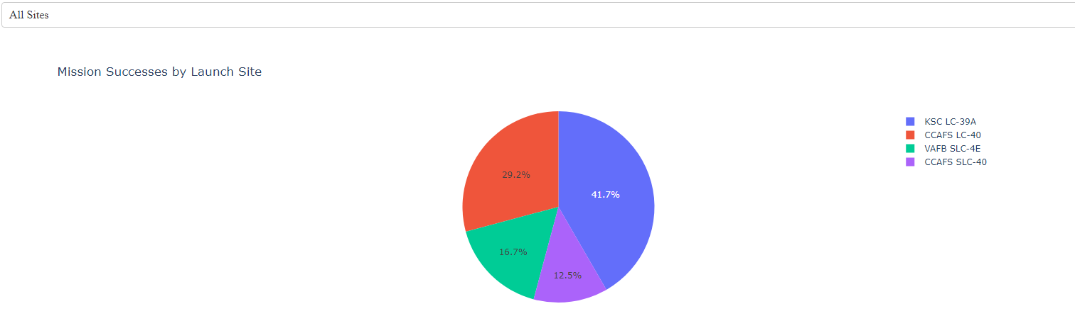
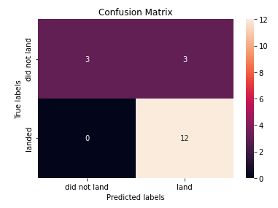
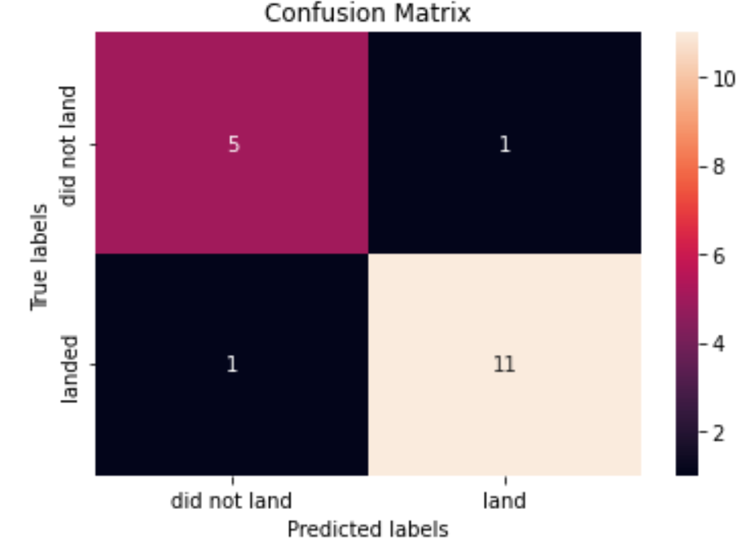
Results
Exploratory data analysis results
We learned a lot about relationships between variables. However, ultimately the approach for predictive methodology was predetermined by the course.
Interactive analytics demo in screenshots
Predictive analysis results:
Most model types (with optimized parameters) returned the same confusion matrix for the test data:
However, the “Decision Tree” model occasionally scored slightly higher, depending on optimization (and inherent randomness)
When the model(s) predicted a launch would not land successfully, it never did. However, the model(s) sometimes wrongly predicted a successful landing.

Slide 17

Section 2

Slide 18
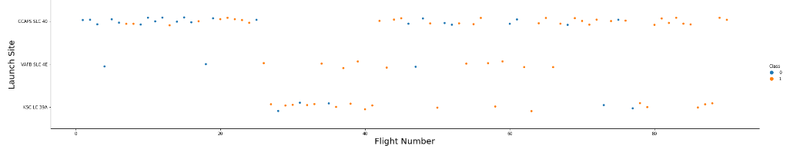
Flight Number vs. Launch Site
Show a scatter plot of Flight Number vs. Launch Site
Show the screenshot of the scatter plot with explanations
Image:
Flight Number vs Launch Site and “Class” (success/failure). Flight numbers correlate with launch site, and appear to see a higher success rate as number increases

Slide 19
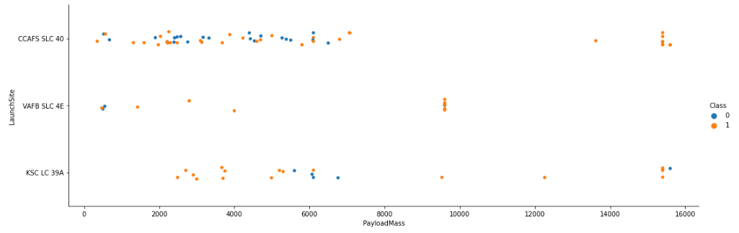
Payload vs. Launch Site
Show a scatter plot of Payload vs. Launch Site
Show the screenshot of the scatter plot with explanations
Image:
Launch Site vs Payload Mass and Class. Payload mass appears to correlate with launch site, launch sites may have min/max acceptable payloads.

Slide 20
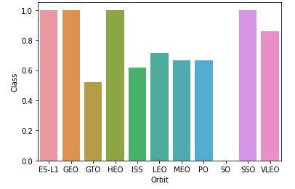
Success Rate vs. Orbit Type
Show a bar chart for the success rate of each orbit type
Show the screenshot of the scatter plot with explanations
Image:
Success Rate vs Orbit type. Some orbits are more successful than others.

Slide 21
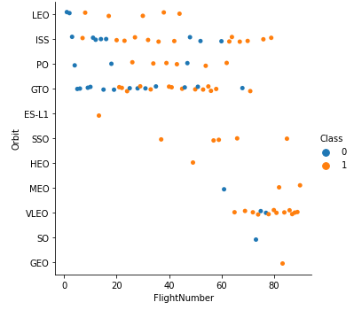
Flight Number vs. Orbit Type
Image:
Orbit type vs flight number. Orbit types correlate with flight number. You can also see here that orbit type success rate may not be as valuable as previously indicated.
Show a scatter point of Flight number vs. Orbit type
Show the screenshot of the scatter plot with explanations

Slide 22
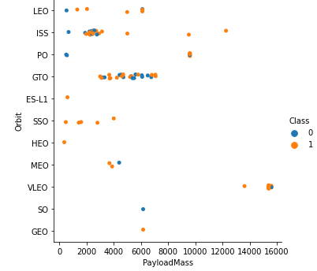
Payload vs. Orbit Type
Image:
Orbit type vs payload mass and class. With heavy payloads the successful landing or positive landing rate are more for Polar, LEO and ISS.
Show a scatter point of payload vs. orbit type
Show the screenshot of the scatter plot with explanations

Slide 23
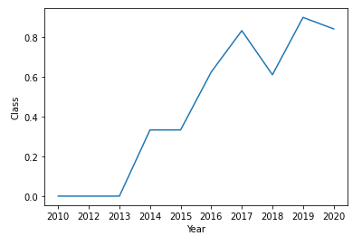
Launch Success Yearly Trend
Show a line chart of yearly average success rate
Show the screenshot of the scatter plot with explanations
Image:
Class average vs year. Success rate increases with year as a trend (though decreases in 2020)

Slide 24
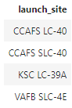
All Launch Site Names
Find the names of the unique launch sites
Present your query result with a short explanation here
SQL statement: SELECT DISTINCT “Launch_Site” FROM SPACEXDATASET
Explanation: Select all unique “Launch_Site” properties within the SPACEXDATASET table.

Slide 25
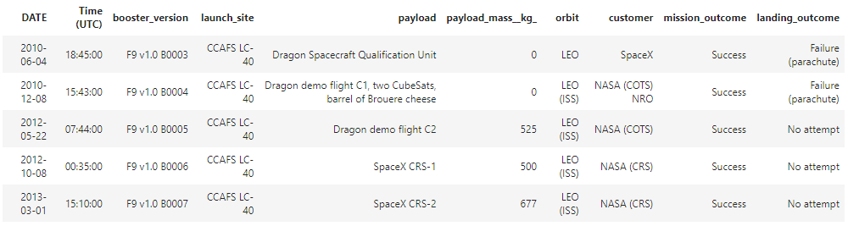
Launch Site Names Begin with 'CCA'
Find 5 records where launch sites begin with `CCA`
Present your query result with a short explanation here
SQL statement: SELECT * from SPACEXDATASET where "Launch_Site" like ‘%CCA%' limit 5
Explanation: Selects first 5 entries from SPACEXDATASET table where “Launch_Site” property contains “CCA”

Slide 26
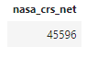
Total Payload Mass
Calculate the total payload carried by boosters from NASA
Present your query result with a short explanation here
SQL statement: SELECT(sum("PAYLOAD_MASS__KG_")) as "NASA_CRS_net" from SPACEXDATASET where "Customer"='NASA (CRS)’
Explanation: Selects the sum of the “PAYLOAD_MASS_KG” column in the SPACEXDATASET table for rows where the “Customer” property is “NASA(CRS)”. Relabels as “nasa_crs_net”.

Slide 27
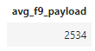
Average Payload Mass by F9 v1.1
Calculate the average payload mass carried by booster version F9 v1.1
Present your query result with a short explanation here
SQL statement: select(avg("PAYLOAD_MASS__KG_")) as AVG_F9_Payload from SPACEXDATASET where "Booster_Version" LIKE 'F9 v1.1%’
Explanation: Selects the average of the “PAYLOAD_MASS_KG_” column in the SPACEXDATASET table where the “Booster_Version” property begins with “F9 v1.1”. Renames as “avg_f9_payload”.

Slide 28
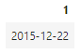
First Successful Ground Landing Date
Find the dates of the first successful landing outcome on ground pad
Present your query result with a short explanation here
SQL statement: select min(Date) from SPACEXDATASET where Landing_Outcome = 'Success (ground pad)’
Explanation: Selects the minimum (earliest) date from the SPACEXDATASET table where the “Landing_Outcome” property is “Success (ground pad)”

Slide 29
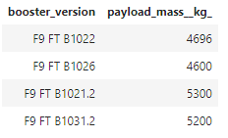
Successful Drone Ship Landing with Payload between 4000 and 6000
List the names of boosters which have successfully landed on drone ship and had payload mass greater than 4000 but less than 6000
Present your query result with a short explanation here
SQL statement: select Booster_Version, PAYLOAD_MASS__KG_ from SPACEXDATASET where Landing_Outcome = 'Success (drone ship)' and PAYLOAD_MASS__KG_ between 4000 and 6000
Explanation: Selects the Booster_Version and PAYLOAD_MASS_KG_ columns from the SPACEXDATASET table where the “Landing_Outcome” property is “Success (drone ship” and the “PAYLOAD_MASS_KG_” property is between 4000 and 6000 (kg)

Slide 30
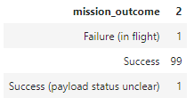
Total Number of Successful and Failure Mission Outcomes
Calculate the total number of successful and failure mission outcomes
Present your query result with a short explanation here
SQL statement: select Mission_Outcome, count(*) from SPACEXDATASET group by Mission_Outcome
Explanation: Selects the “Mission_Outcome” column of the SPACEXDATASET table and counts the instances of each unique entry

Slide 31
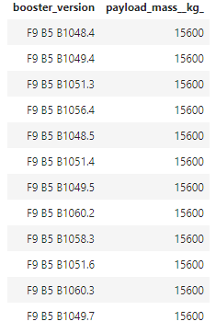
Boosters Carried Maximum Payload
List the names of the booster which have carried the maximum payload mass
Present your query result with a short explanation here
SQL statement: select Booster_Version, PAYLOAD_MASS__KG_ from SPACEXDATASET where PAYLOAD_MASS__KG_ = (select max(PAYLOAD_MASS__KG_) from SPACEXDATASET)
Explanation: Selects “Booster_Version” and “PAYLOAD_MASS__KG_” columns from the SPACEXDATASET table where the “PAYLOAD_MASS__KG_” value is equivalent to the maximum of all entries in the “PAYLOAD_MASS__KG_” column

Slide 32
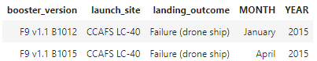
2015 Launch Records
List the failed landing_outcomes in drone ship, their booster versions, and launch site names for in year 2015
Present your query result with a short explanation here
SQL statement: select Booster_Version, Launch_Site, Landing_Outcome, monthname(Date) as Month, year(Date) as Year from SPACEXDATASET where Landing_Outcome = 'Failure (drone ship)’ and year(Date) = 2015
Explanation: Selects columns “Booster_Version”, “Launch_Site”, “Landing_Outcome” from table SPACEXDATASET where the property “Landing_Outcome” is “Failure (drone ship)” and the year of the property “Date” is 2015. Adds “Month” and “Year” columns based on “Date” property.

Slide 33
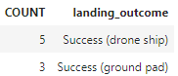
Rank Landing Outcomes Between 2010-06-04 and 2017-03-20
Rank the count of landing outcomes (such as Failure (drone ship) or Success (ground pad)) between the date 2010-06-04 and 2017-03-20, in descending order
Present your query result with a short explanation here
SQL statement: select count(*) as Count, Landing_Outcome from SPACEXDATASET where Landing_Outcome like '%Success%' and Date > '2010-06-04’ and Date < '2017-03-20’ group by Landing_Outcome
Explanation: Selects “Landing_Outcome” column from SPACEXDATASET where “Landing_Outcome” property contains “Success” and the “Date” property is between 2010-06-04 and 2017-03-20, then counts instances of unique “Landing_Outcome” entries, labeled as “Count”.

Slide 34

Section 3

Slide 35
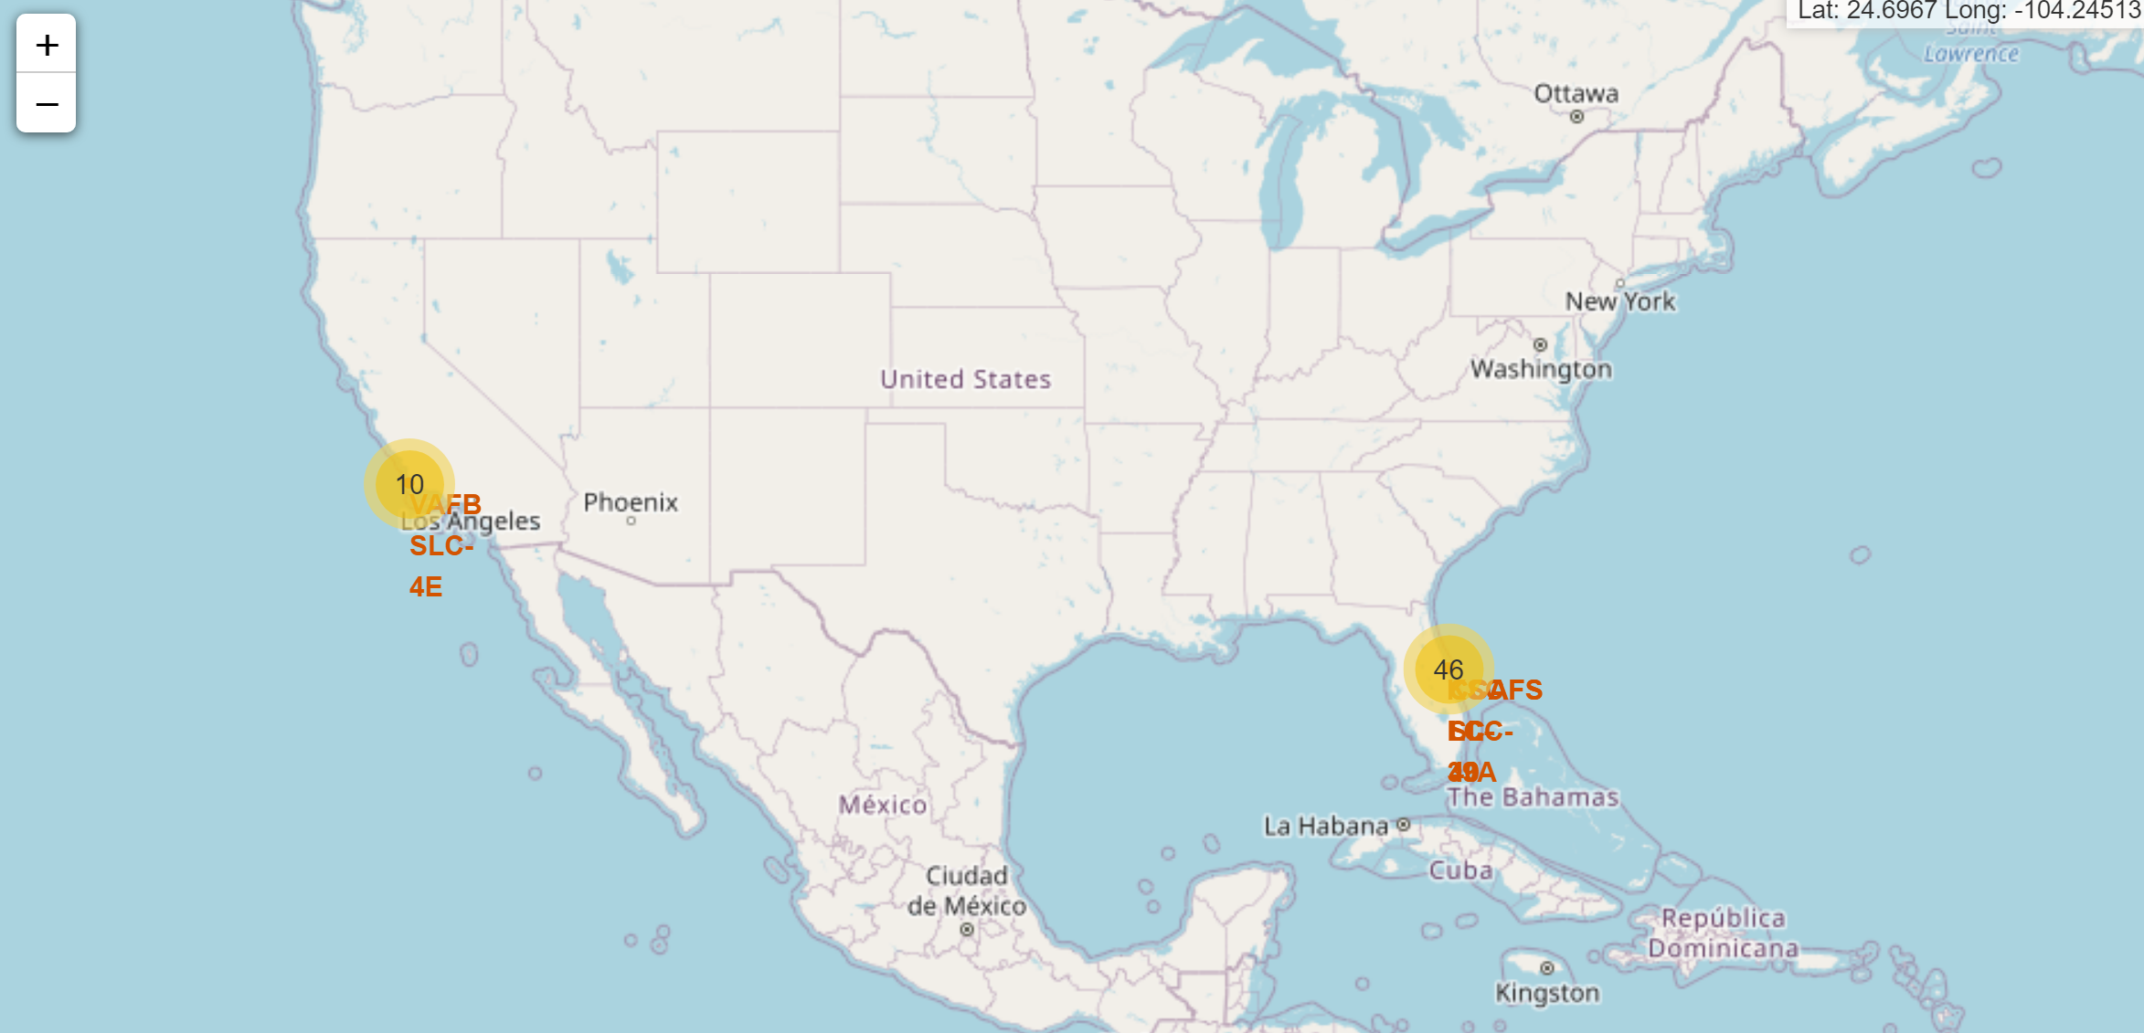
Launch Site Locations
Replace <Folium map screenshot 1> title with an appropriate title
Explore the generated folium map and make a proper screenshot to include all launch sites’ location markers on a global map
Explain the important elements and findings on the screenshot
Launch sites marked on map. Numbers indicate launches in each region (florida is actually two locations, but are aggregated due to proximity at zoom scale).

Slide 36
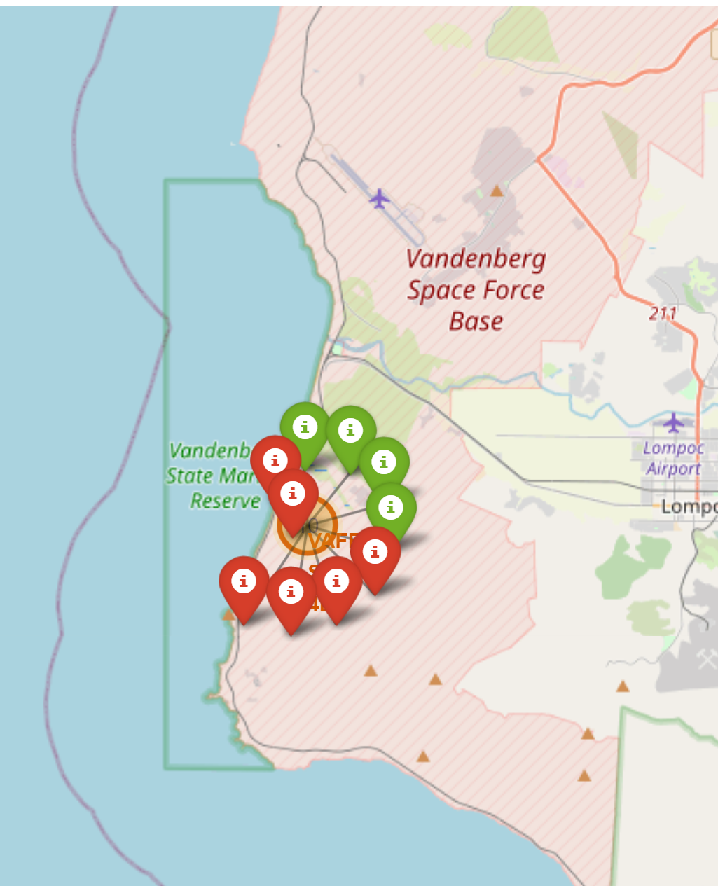
VAFB Launch Success and Failures
Replace <Folium map screenshot 2> title with an appropriate title
Explore the folium map and make a proper screenshot to show the color-labeled launch outcomes on the map
Explain the important elements and findings on the screenshot
Green markers indicate successful launches, while red markers indicate unsuccessful.

Slide 37
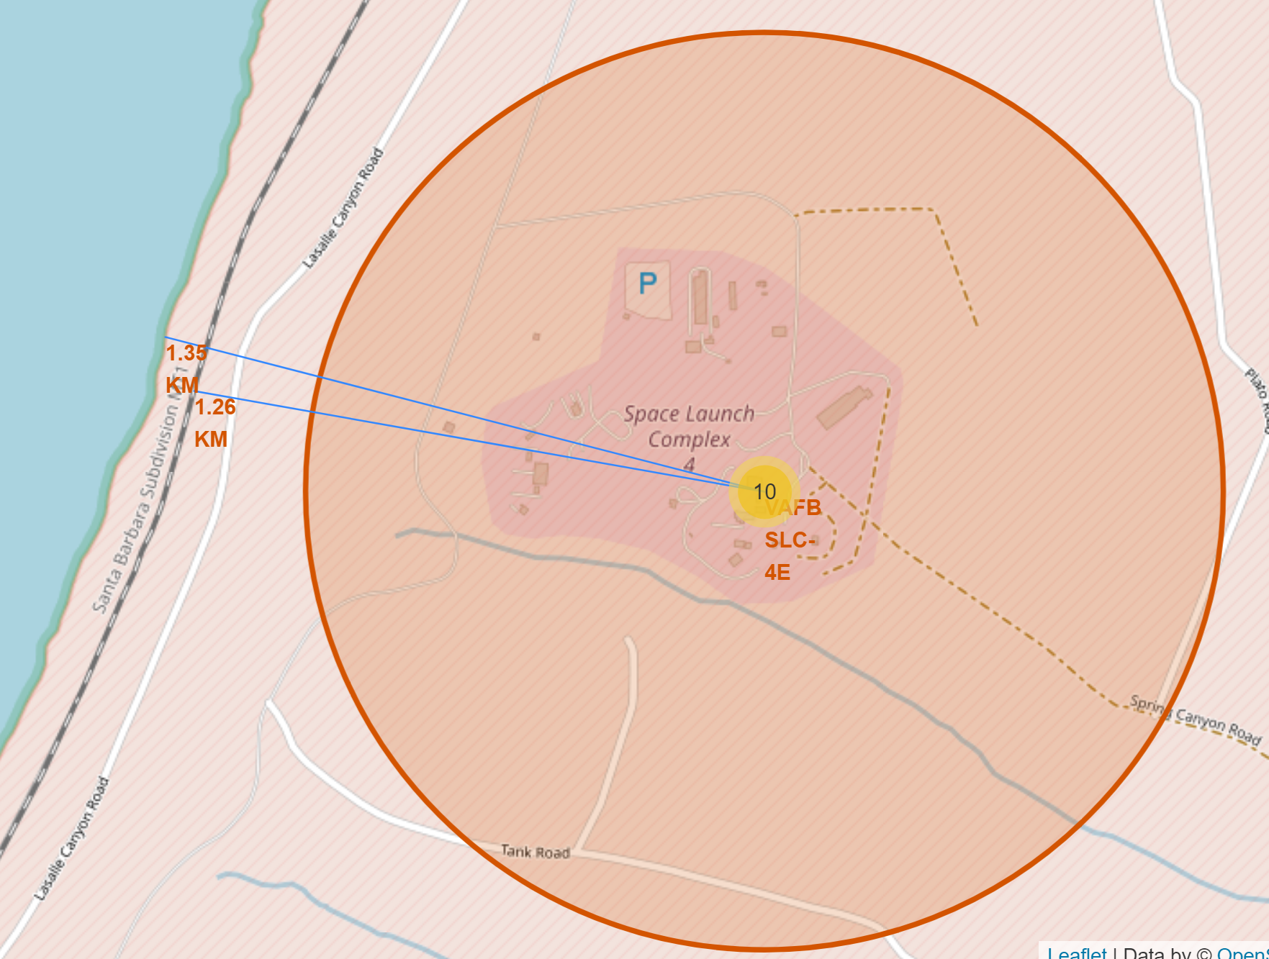
Distances to Coastline and Railway
Replace <Folium map screenshot 3> title with an appropriate title
Explore the generated folium map and show the screenshot of a selected launch site to its proximities such as railway, highway, coastline, with distance calculated and displayed
Explain the important elements and findings on the screenshot
Blue lines and labels show distances from launch point to coastline and railway

Slide 38

Section 4

Slide 39
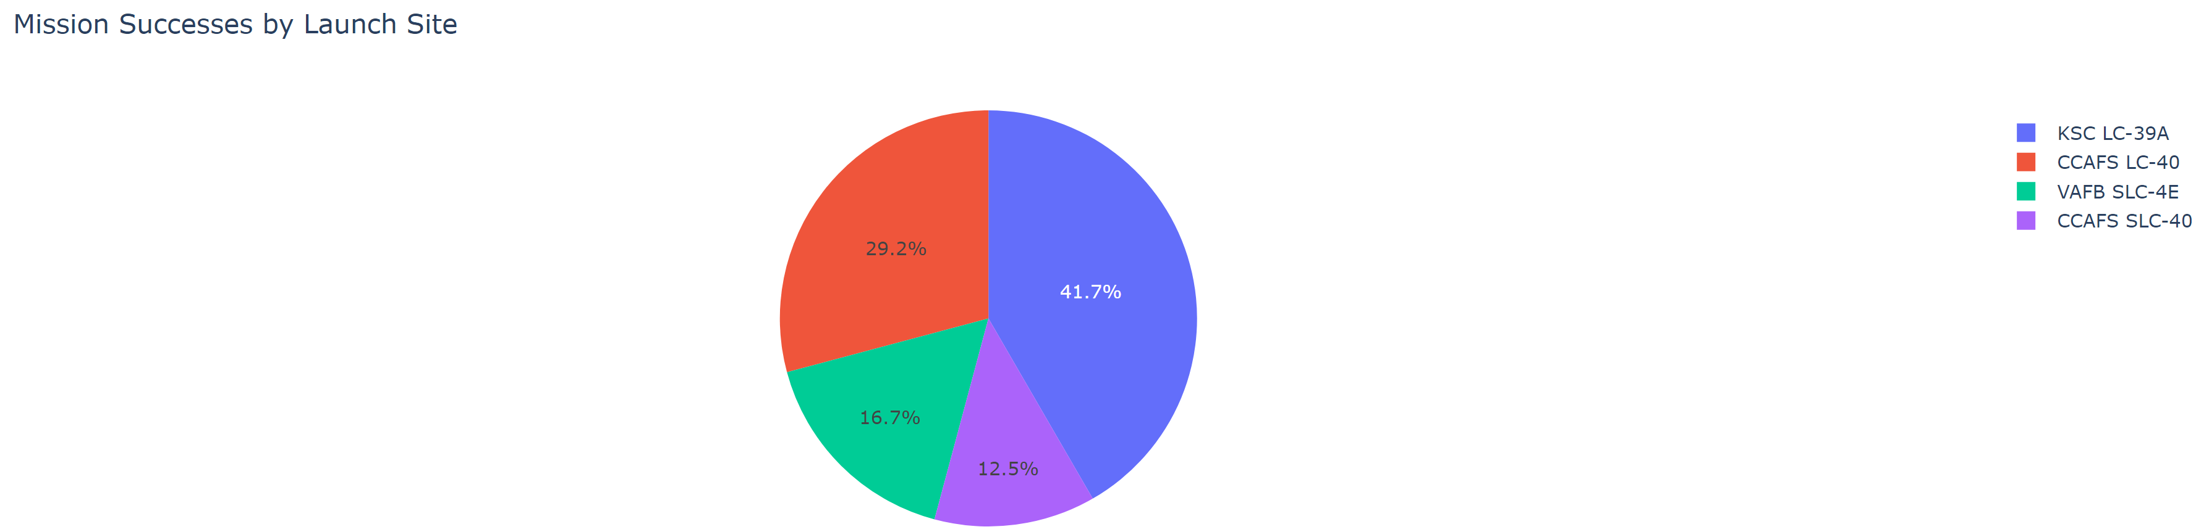
Launch Success Pie Chart
Replace <Dashboard screenshot 1> title with an appropriate title
Show the screenshot of launch success count for all sites, in a piechart
Explain the important elements and findings on the screenshot
Shows proportion of successes from each launch site. E.g., 41.7% of launch successes were at KSC LC-39A.

Slide 40
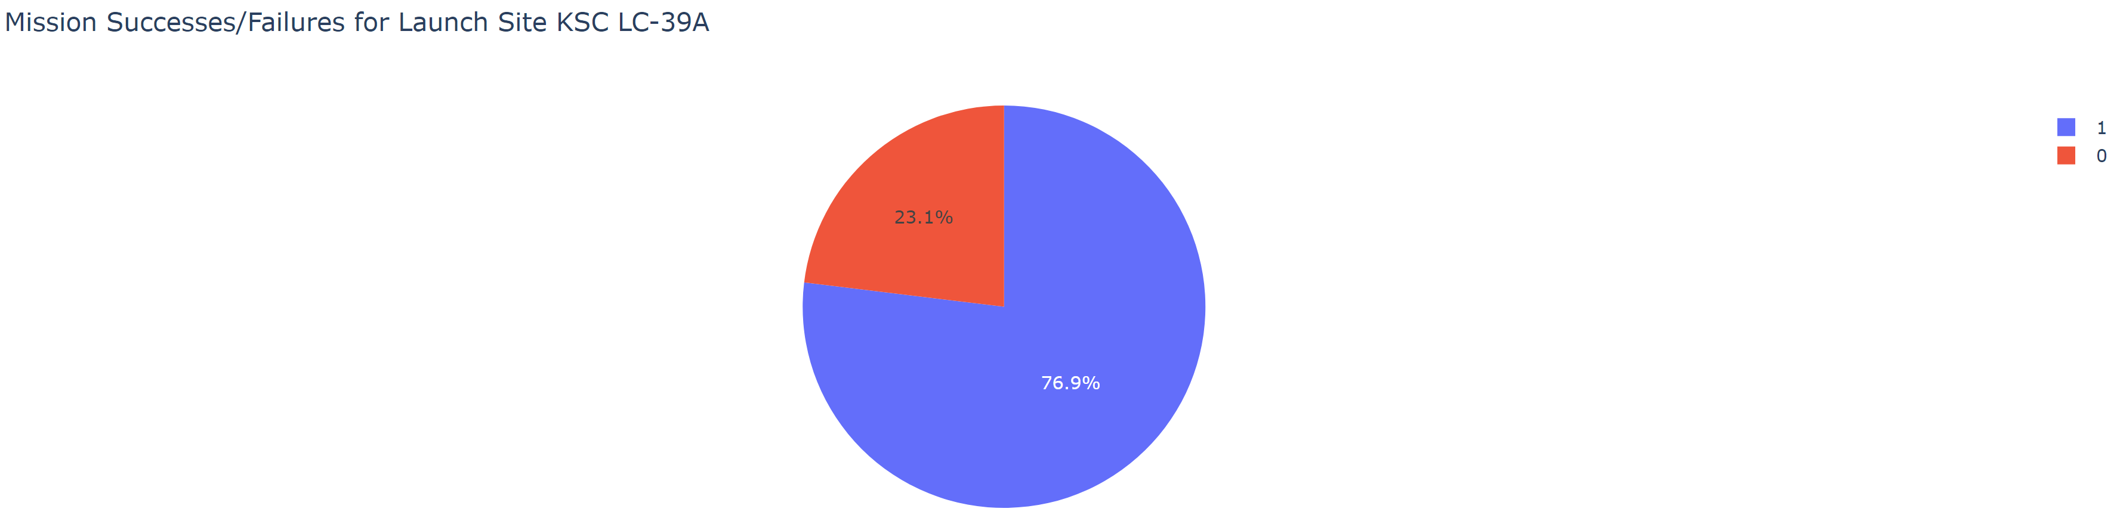
Mission Successes/Failures for KSC LC-39A
Replace <Dashboard screenshot 2> title with an appropriate title
Show the screenshot of the piechart for the launch site with highest launch success ratio
Explain the important elements and findings on the screenshot
The launch site with the highest success ration was KSC LC-39A, which saw 76.9% of launches resulting in a successful outcome.

Slide 41
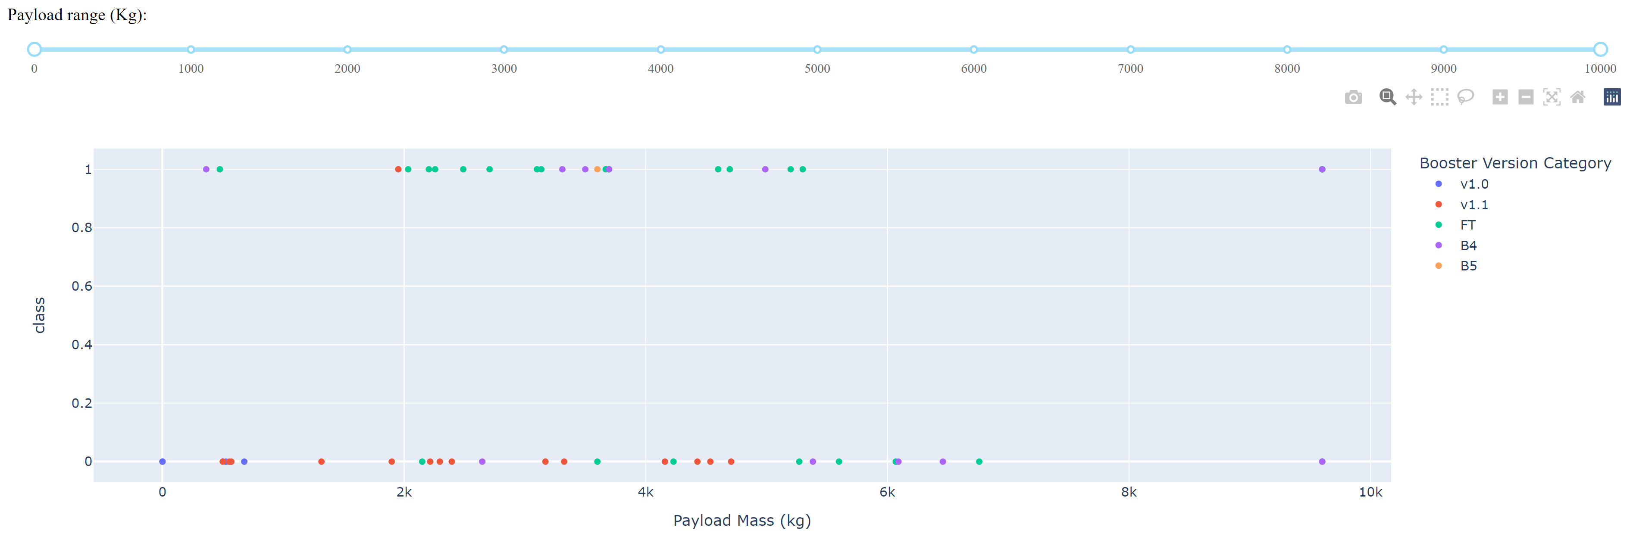
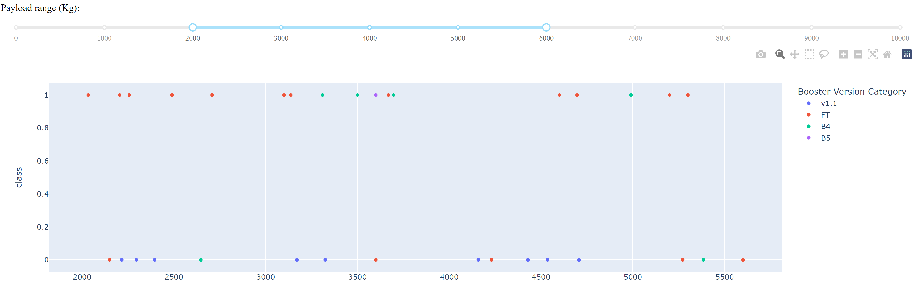
Payload vs Launch Outcome for All Sites, by payload
Replace <Dashboard screenshot 3> title with an appropriate title
Show screenshots of Payload vs. Launch Outcome scatter plot for all sites, with different payload selected in the range slider
Explain the important elements and findings on the screenshot, such as which payload range or booster version have the largest success rate, etc.
Payload vs Launch Outcome for All Sites – 1) all payloads and 2) 2000-6000kg
“FT” booster version has the most overall successes, with most occurring in the 2000-6000kg range.

Slide 42

Section 5

Slide 43
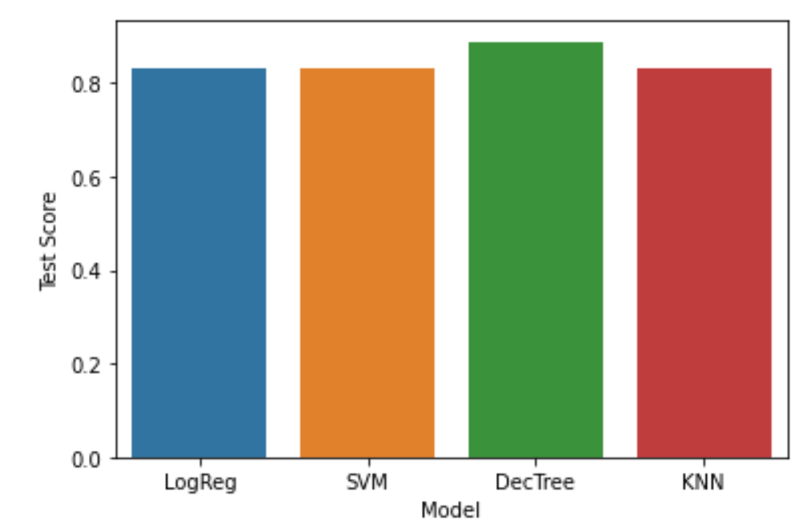
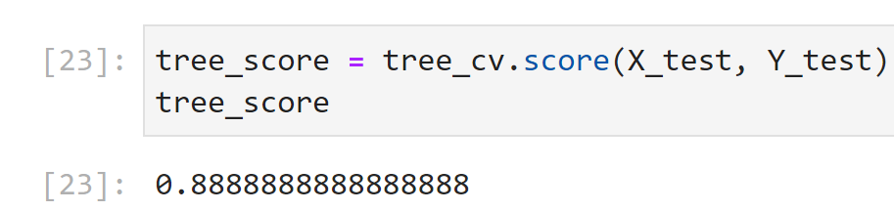
Classification Accuracy
Visualize the built model accuracy for all built classification models, in a bar chart
Find which model has the highest classification accuracy
“Decision Tree” achieved the highest classification accuracy, with a score of 0.889
However, this outcome was rare and dependent on the “GridSearchCV” parameter optimization findings, which were inconsistent (likely due to random ‘fold’ selection)
Parameters for this model are shown below:

Slide 44
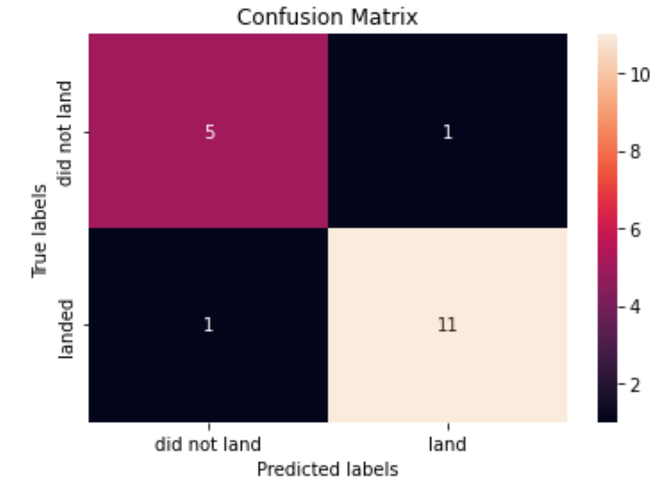
Confusion Matrix
Show the confusion matrix of the best performing model with an explanation
Confusion matrix for decision tree classifier with parameters shown in previous slide.
The model made correct predictions on the test data in 16 out of 18 cases.
There is a small chance of this model predicting both a false positive and a false negative.

Slide 45
Conclusions
While the decision tree classification model shown may technically have the best ‘score’, it may not be the preferred model depending on prioritization. E.g., a model which is less likely to predict a false negative (incorrect prediction of failure) may be preferred.
Due to variability in the outcome of the decision tree parameter optimization, the GridSearchCV optimizer inputs should be explored further. It should also be noted that in some cases this model was overfit to the training data – scoring better in the parameter optimization process, but worse on the accuracy scoring algorithm (with test data).
Further context is necessary to produce a business recommendation – what are the priorities for this prediction tool?
Model selection could be further evaluated on a fundamental level to yield more confidence. E.g., how do assumptions integral to a ‘decision tree’ model compare to those of a logistic regression model?

Slide 46
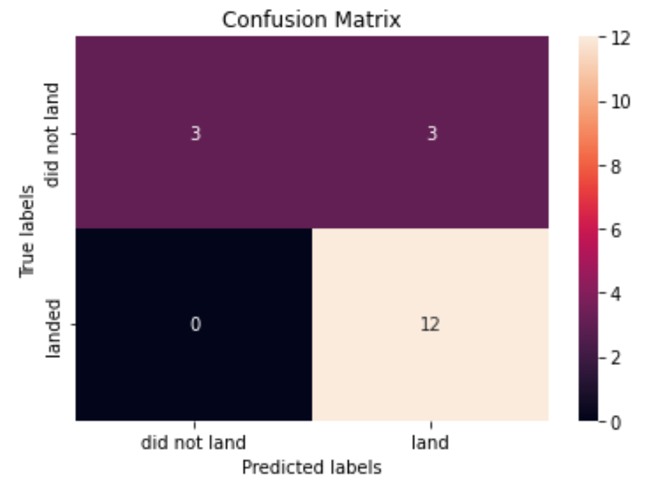
Appendix
Include any relevant assets like Python code snippets, SQL queries, charts, Notebook outputs, or data sets that you may have created during this project
Most models produced the following confusion matrix:
This may be preferable, as it allows more confidence in aborting an upcoming launch event.

Slide 47


